Slide 1


Slide 2


Premier League
Team Members:
1. Mohamed Sabry Mahmoud.
2. Mohamed Ahmed Mohamed Emam.
3. Fatima Ibrahim Kamel.
4. Mohamed Tarek Amin.
5.Leqaa Mohamed Abdallah.
6. Mohamed Bahgat Abdel Khaleq.

Slide 3
purpose
Knowing the English Premier League news daily.
Follow the standings and scorers of the English Premier League.
Knowing the standings of teams and players.
Knowing the news of the league players and the goals of each player and how much is assisted.

Slide 4
overview
This project provides easy access to information about the English Premier League and helps the user to reach all the results he wants from knowing the teams, coaches, clubs, goals of each team and a defect.
When the project starts, a welcome window appears and the user is asked to enter his email and password to be able to login. There is a login button that takes you to the next window if the data entered is correct and if an error message does not appear.

Slide 5
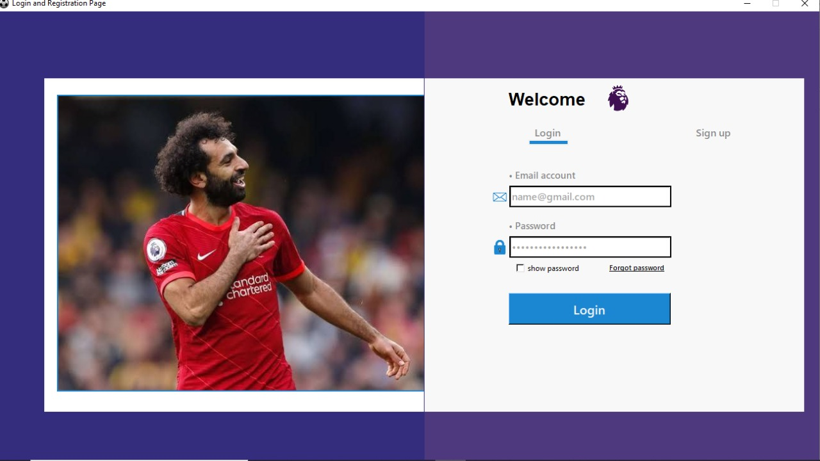

Slide 6

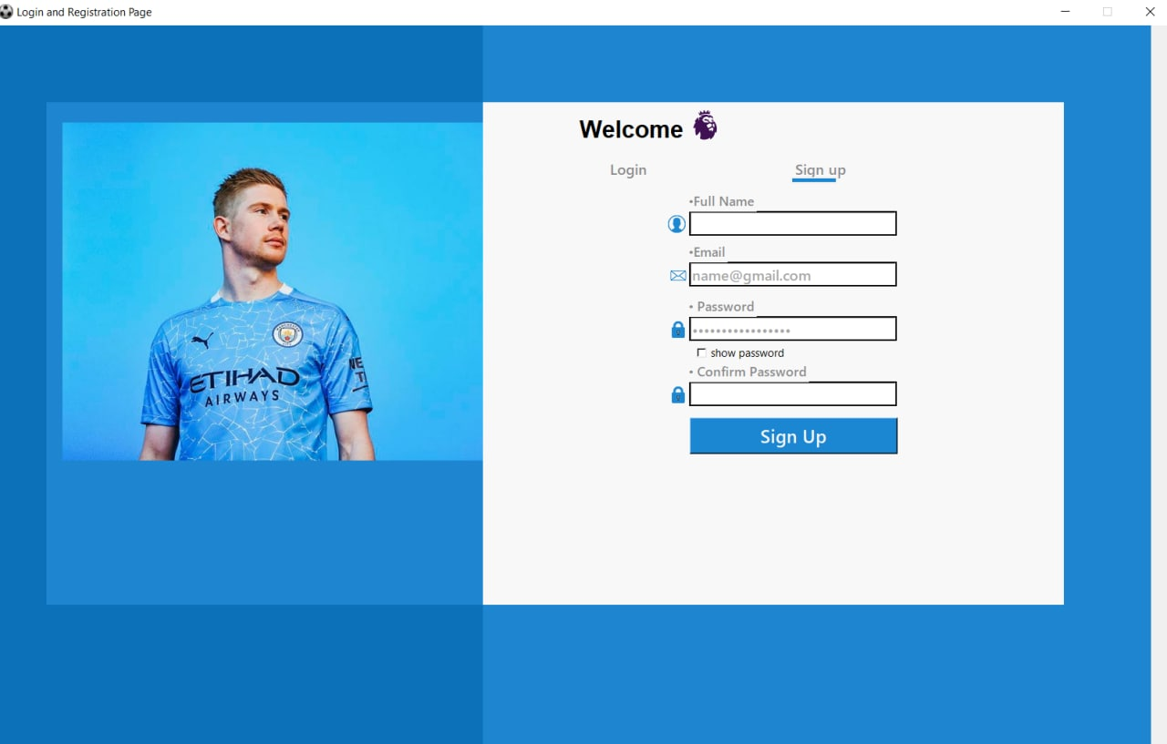
And if he does not have an account, he can click on sign up, a window appears and the required data is entered such as name, password, e-mail and password confirmation, and then a message is received on the e-mail that enables you to enter the application by adding the new user to the database.

Slide 7
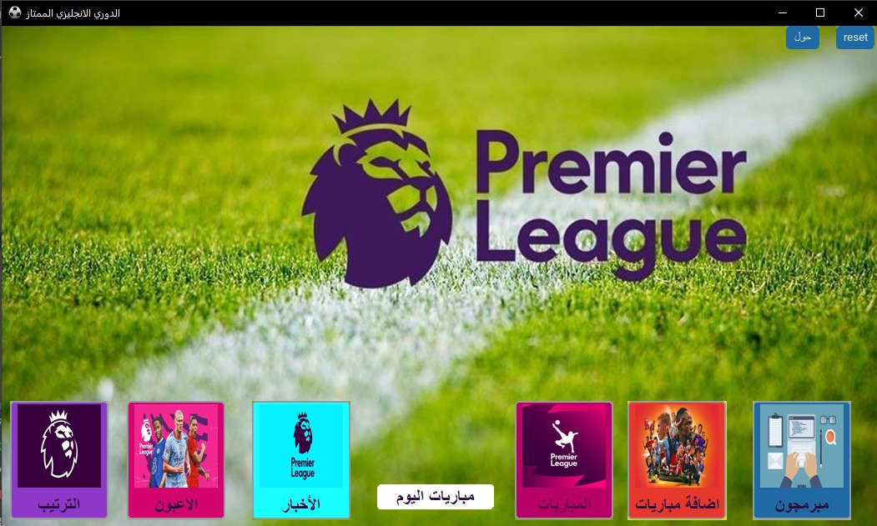
When you log in, the main window appears and contains many buttons.

Slide 8
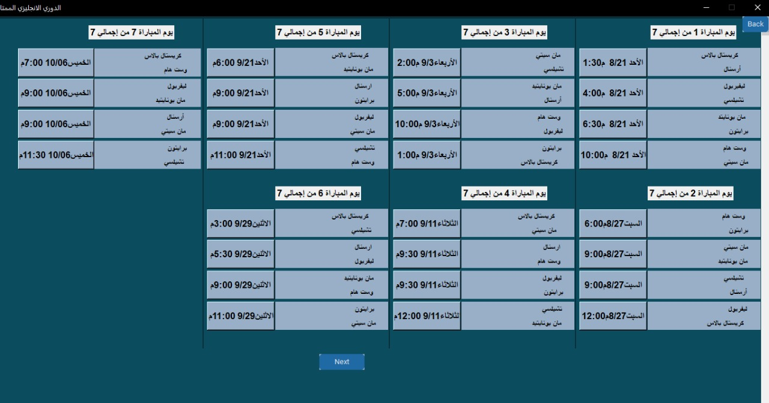
When you click on the matches"المباريات"button, the dates of the matches appear and each two teams next to them the date and the date is a button when you press it, it will move to the history of the confrontations between the two teams.

Slide 9
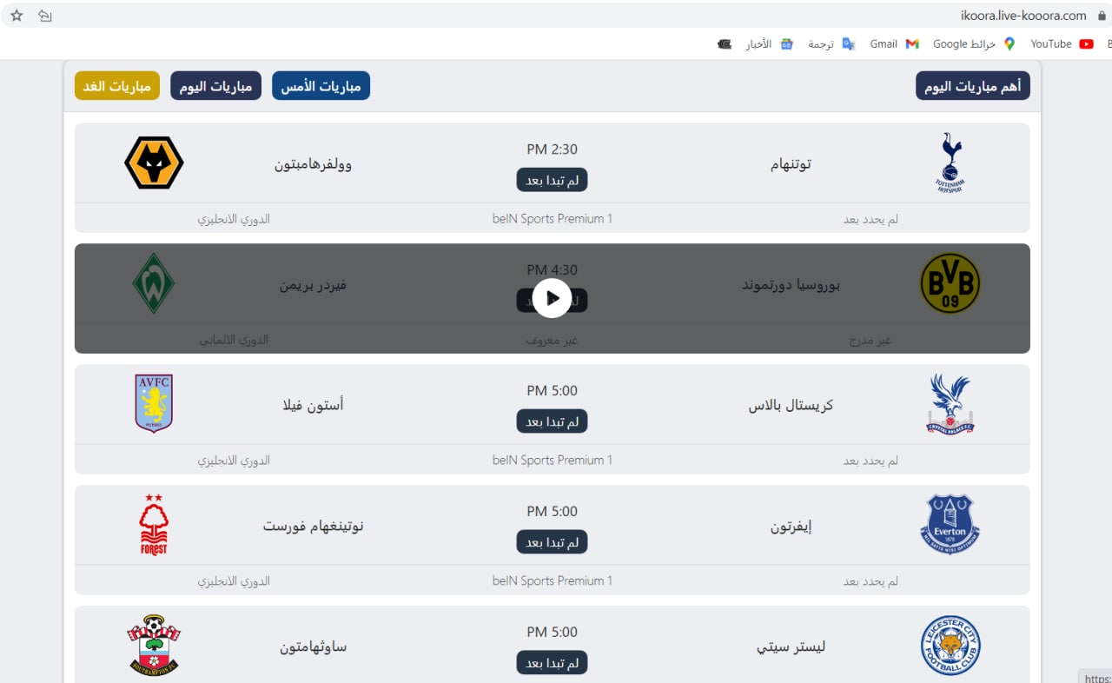
When you click on the Matches of the Day مباريات اليوم" "button, it goes to the web browser and the matches of that day are displayed.

Slide 10
When we click on the news"الاخبار" button, we will be transferred to the web browser with the same news in detail, and there is also a button at the bottom called More"المزيد" that moves to the web browser today's news and the news changes daily and is not fixed, and some news has been added .

Slide 11
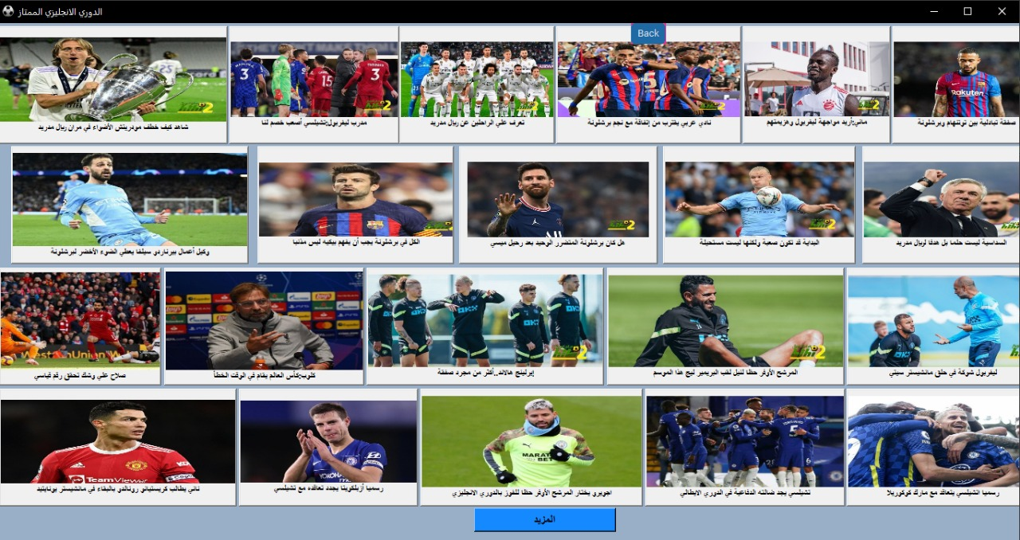

Slide 12
When you click on the Players"اللاعبون" button, a window appears containing two combobox. The one who is right now determines: I want to search by name, age, team, number of goals, number of assists, and the other one in the left. I can search by the name of the player, type the name, and I can write the age if I search for age, and so on, and a table appears with the result When you press search.

Slide 13
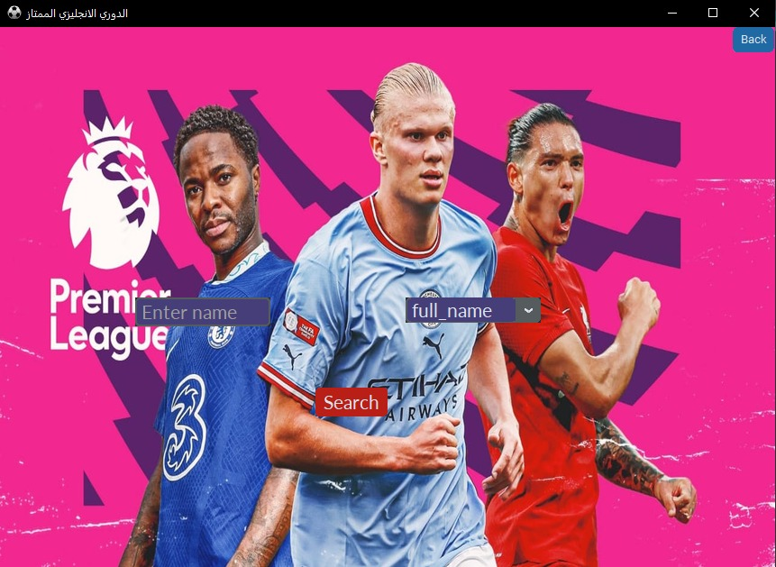

Slide 14
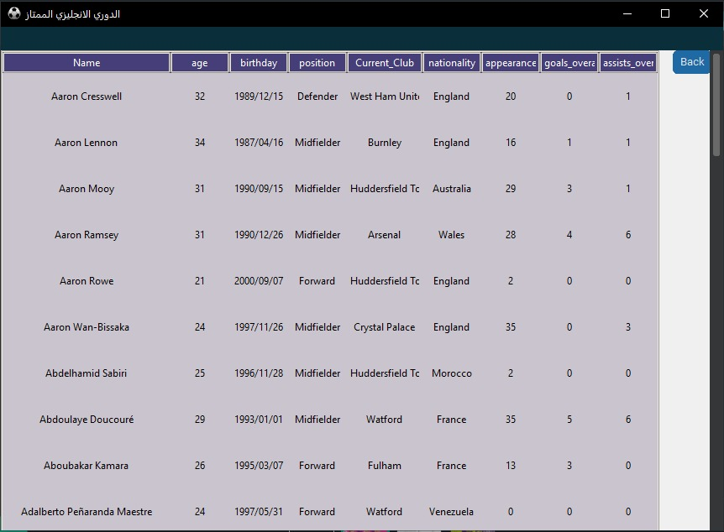

Slide 15
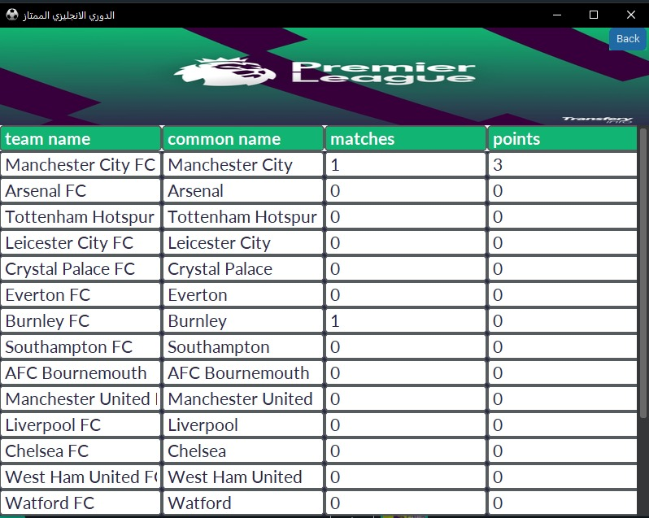
When you press the Arrange"الترتيب" button, a window appears showing the standings of the teams, their common names, the number of matches and points each team has obtained.

Slide 16
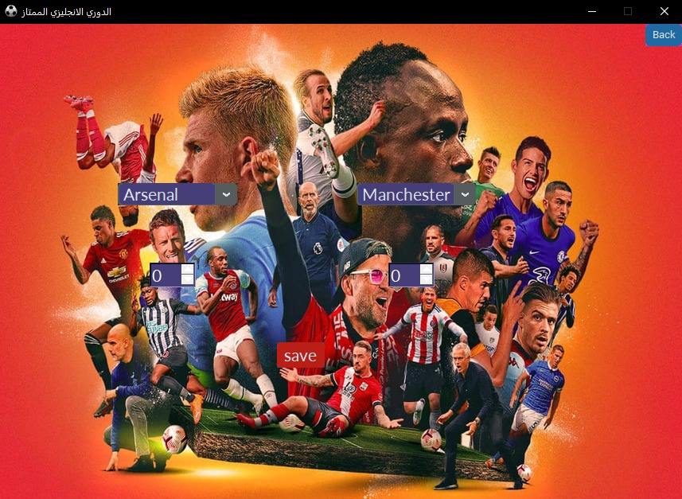
When you press the Add Matches"اضافه مباريات" button, the admin-controlled window appears, but he can add any two teams and their results, as the winning team adds three points, and in case of a tie, one point for each team and when losing zero points, and they are arranged according to the highest points.

Slide 17
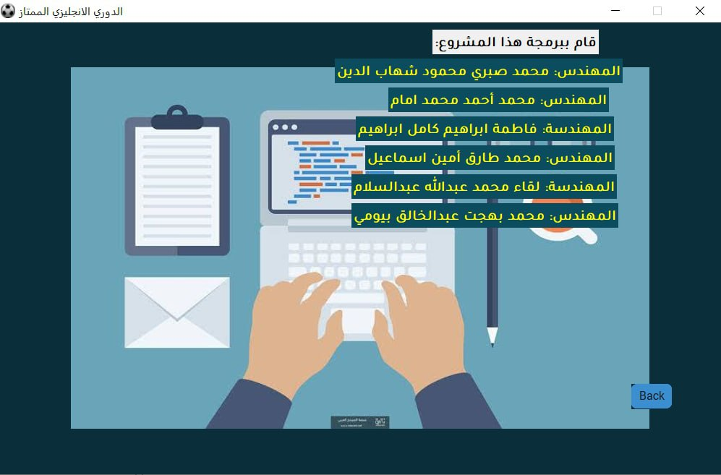
When you press the programmers"المبرمجون"button, a window with their names appears.

Slide 18
There are two buttons on the main screen:
rest Makes all teams points zero.
حولIt displays information about the English Premier League, the best teams, who are the best coaches, the best flaws, the origin of my nation, and so on.
Note : The project is renewable and more features will be provided in it.

Slide 19
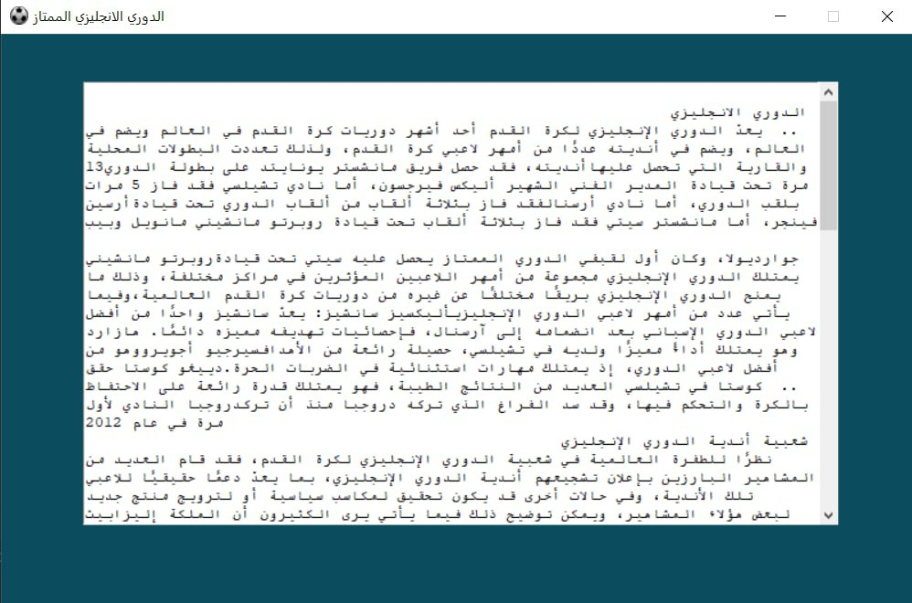

Slide 20
Thanks

